Slide 1
Team 4
Team 4
presenters:
Daniel Pulliam
Kayla blais
Madeline Rondino
Savi Rahiman
Steven Quintero

Slide 2

What is the most popular national park in the united states?

Slide 3
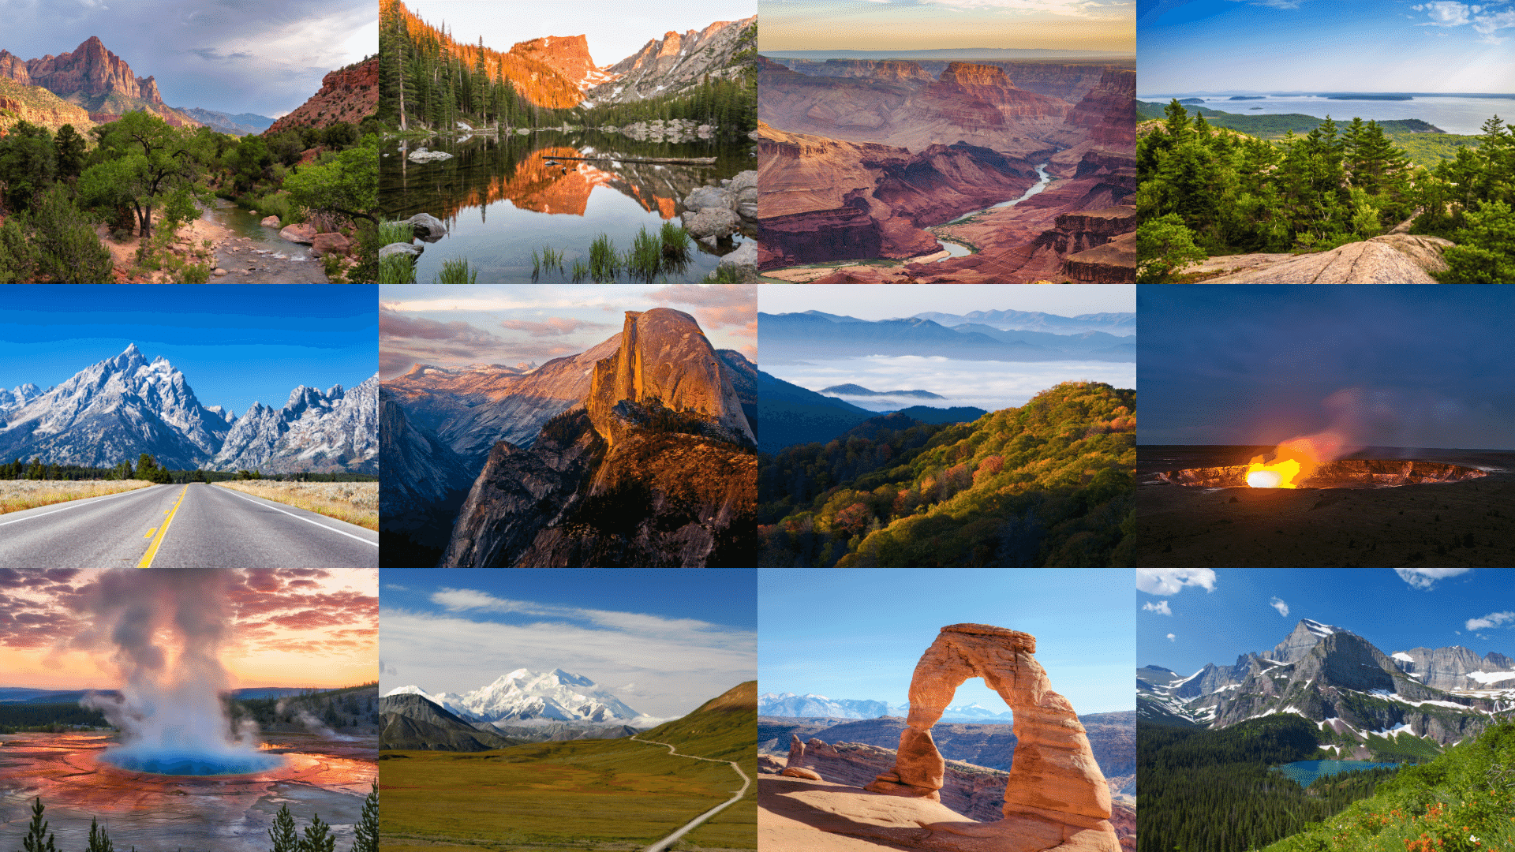
Contents
Data Collection and Cleaning
How many National Parks are there? Where are they located?
What Park is the most popular? (By hours spent in the park)
What Park is the most popular? (by number of visits)
What is the average time per visitor spent in the park by season and region?
How does seasonality affect the popularity of the National Parks?

Slide 4
Data Collection and Cleaning
National Parks, National Reports Query Builder for Traffic Counts (1985-Last Calendar Year). This report displays monthly or annual traffic counts. Data for all of 2023 was downloaded and saved in the Resource folder titled "2023_national_park_public_data.csv".
The query data set did not include the Latitude and Longitude. Resource on the web such as https://www.latlong.net/ was leveraged to create a list of National Park Names with it's Lat & Lon. This was saved in the Resource folder titled "national_park_names.csv".
National Park Service NPS Data API to retrieve activities in select park leveraging the UnitCode provided from the query builder. Documentation on NPS Data API can be found here https://www.nps.gov/subjects/digital/nps-data-api.htm and saved as a jupyter notebook

Slide 5
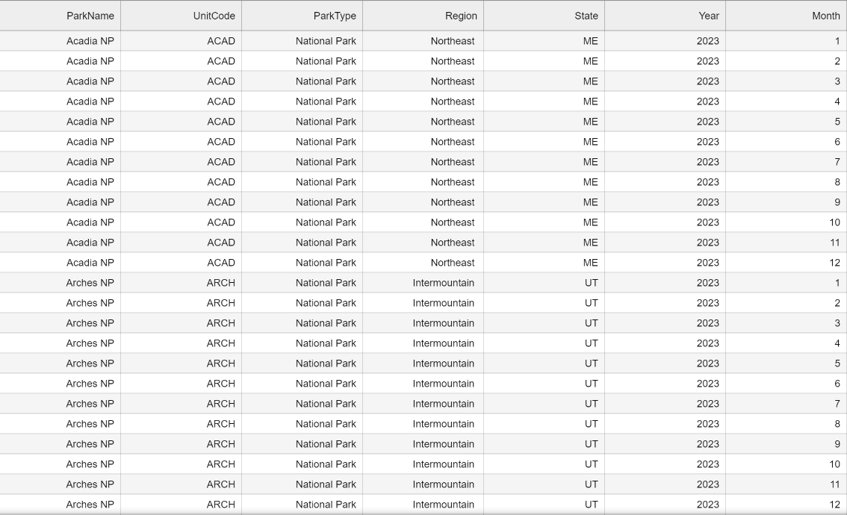
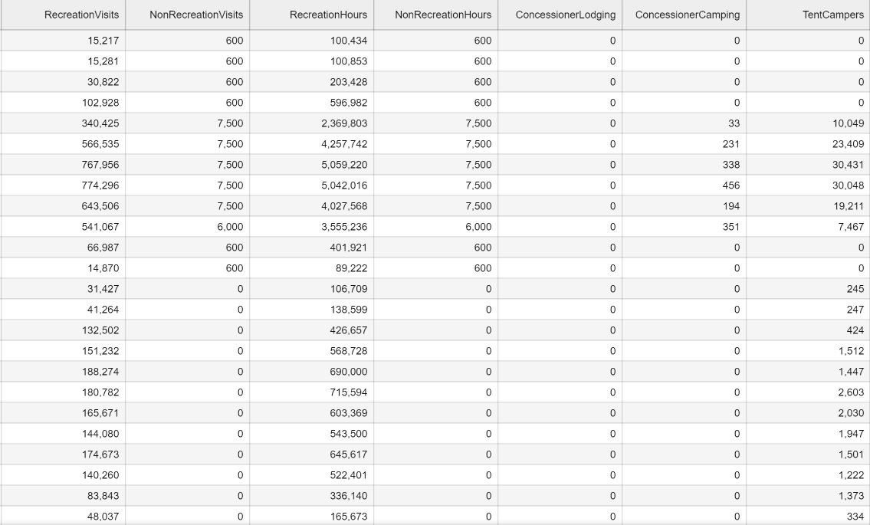
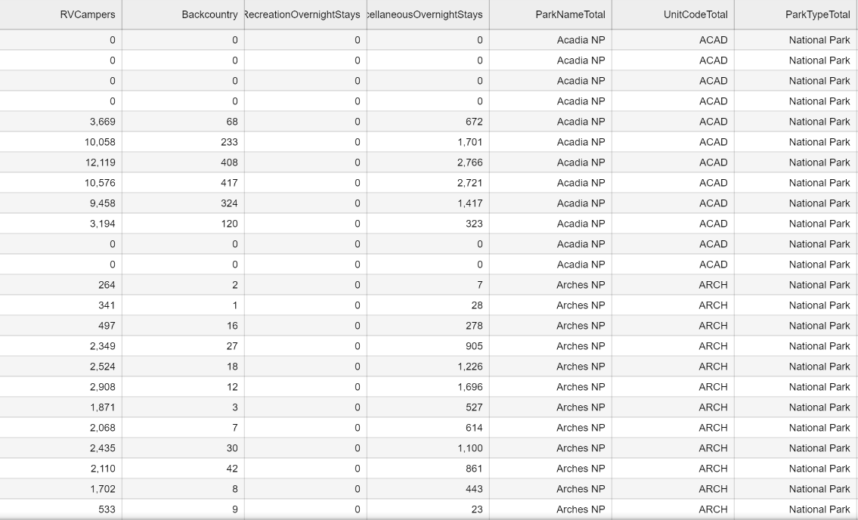
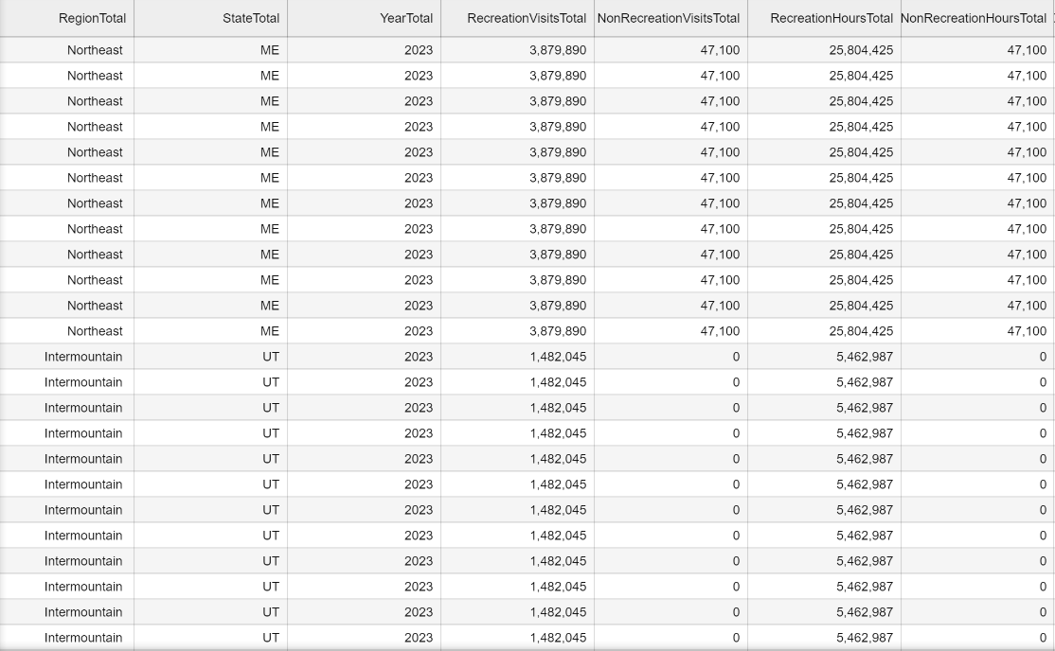

Slide 6
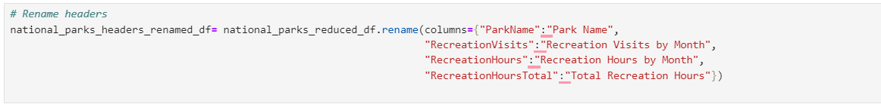
Data Cleaning

Slide 7
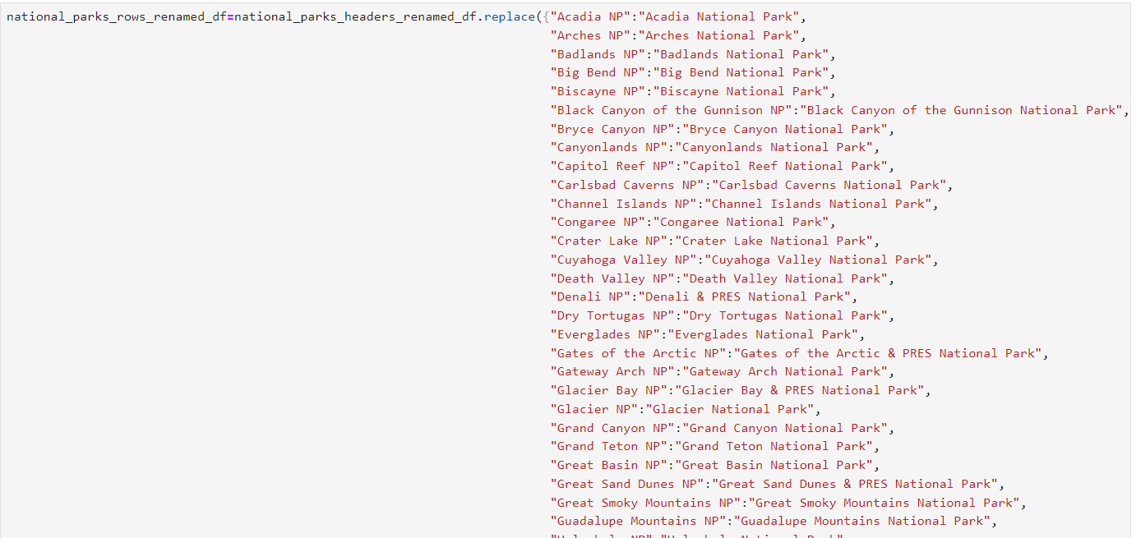
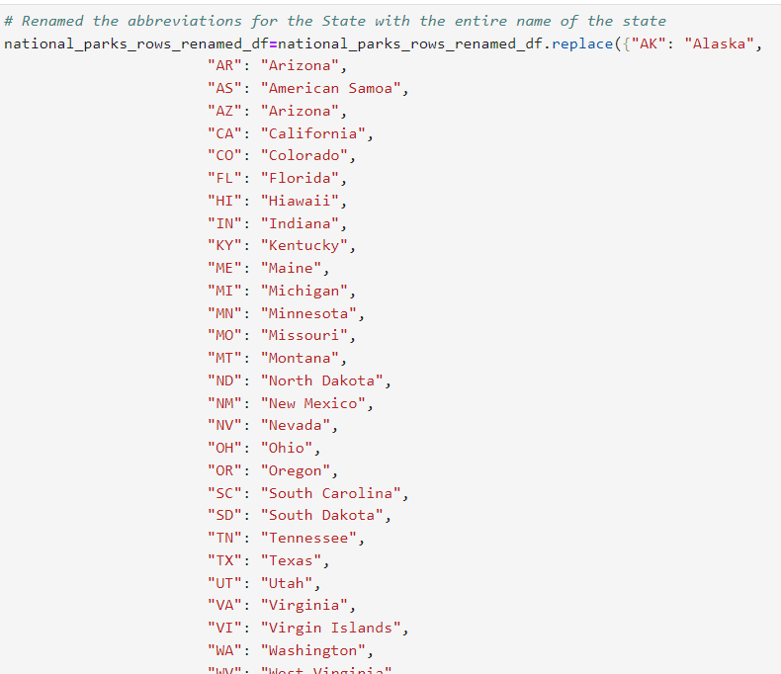
Data cleaning
The Park names needed to be changed in order to merge correctly with the Lat/Lon csv
State abbreviations were renamed to display the full state name.

Slide 8
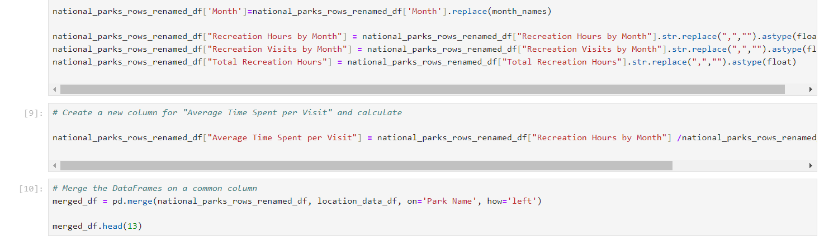
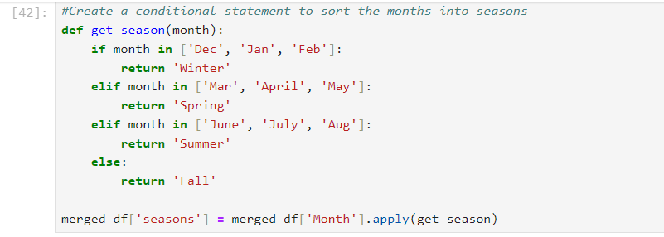
Data cleaning
The data types of “Recreation Visits by Month”, “Recreation Hours by Month”, and “Total Recreation Hours” were changed in order to calculate sums and averages during later analysis.
A function was created to group the months into seasons.

Slide 9
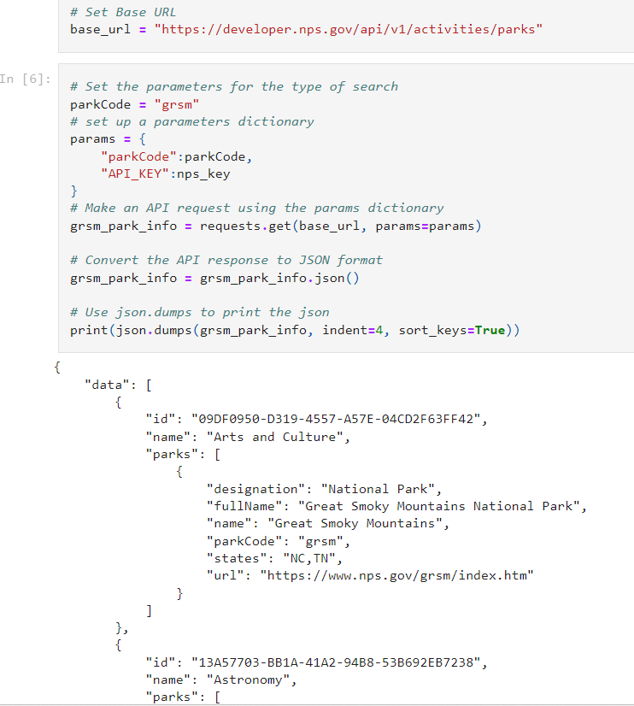
Data cleaning
The API was converted to json and printed to assist in in retrieving the different activities offered in the parks.

Slide 10
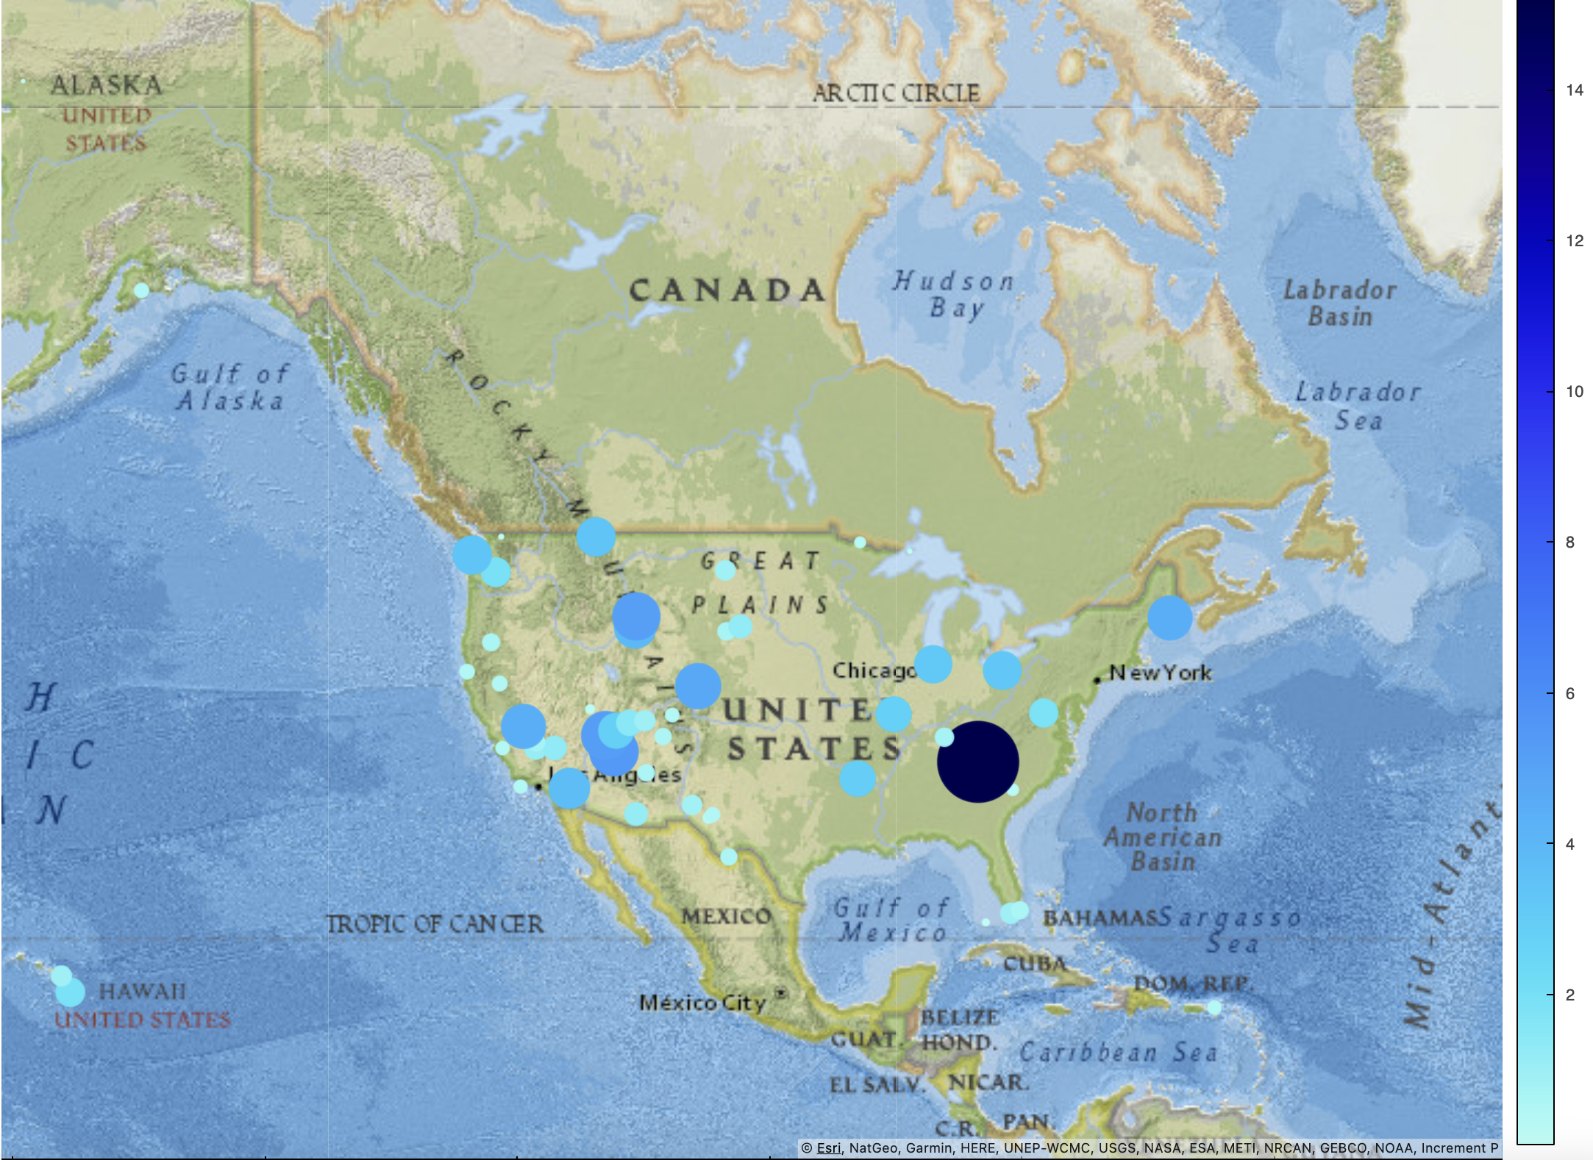
How many National Parks are there? Where are they located?
There are 63 National Park in the US, each of which are plotted on the map.
The size of the bubble represents the total Recreation Visits by the park for the year 2023.
The color density represents the percent of Recreation Visits.
Ranging from 0.012% at the Gates of the Artic National Park in Alaska to 14.4% at the Great Smoky Mountain National Park in Tennessee.
The Gates of the Artic
Great Smoky Mountain

Slide 11
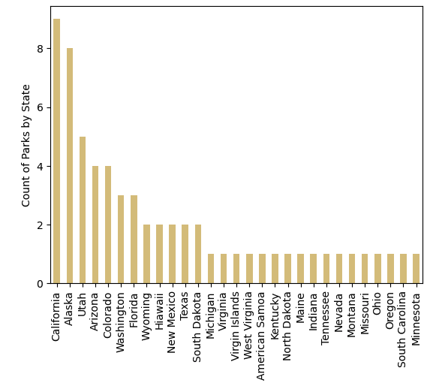
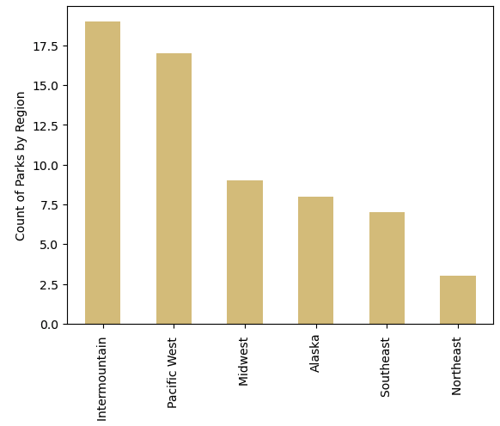
How many National Parks are there? Where are they located?
Alaska, Intermountain, Midwest Northeast, Pacific West & the Southeast are the 6 region that houses the 63 National Parks.
The bar graph to the right shows the distribution of the National Parks by the State they are located in.

Slide 12
How to define “Popularity”

Slide 13
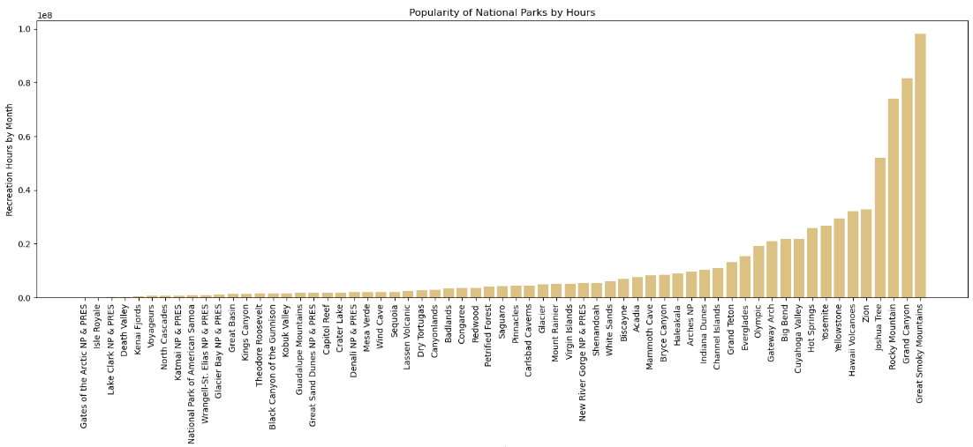
What Park is the most popular? (By hours spent in the park)
When comparing the parks by the total number of recreation hours for the year 2023, the Great Smokey Mountains park came out on top with 98,083,629 hours per year.

Slide 14
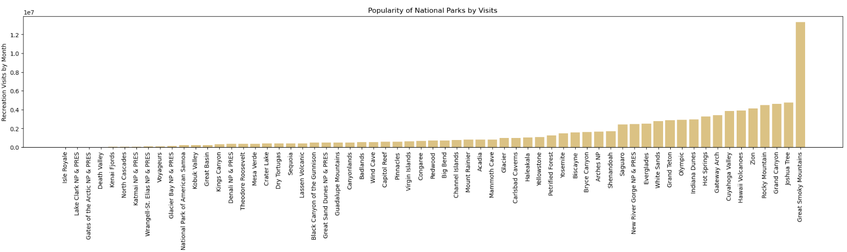
What Park is the most popular? (by number of visits)
When comparing the parks by the total number of recreational visits for the year 2023, the Great Smokey Mountains park came out on top with 13,297,647 visits per year.

Slide 15
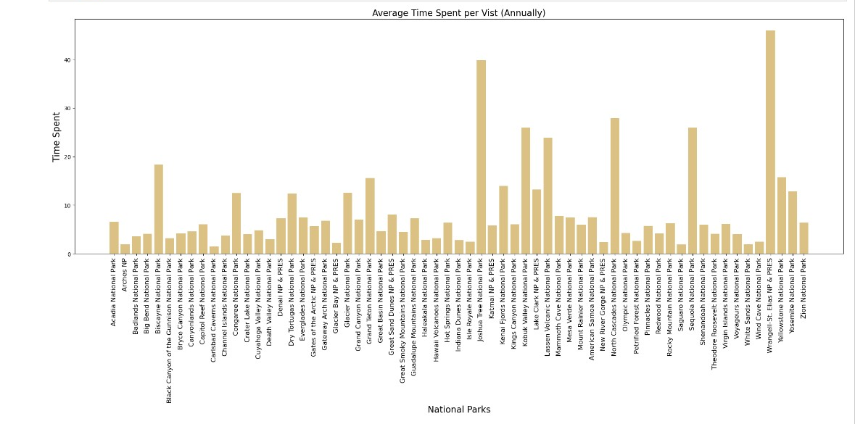
What Park is the most popular? (by Average Time Spent per visit)
When comparing the parks by average time spent per visitor throughout the entire year, Wrangell-St Elias National Park was the highest with 46 hours spent per visitor.

Slide 16
How Does seasonality affect popularity?

Slide 17
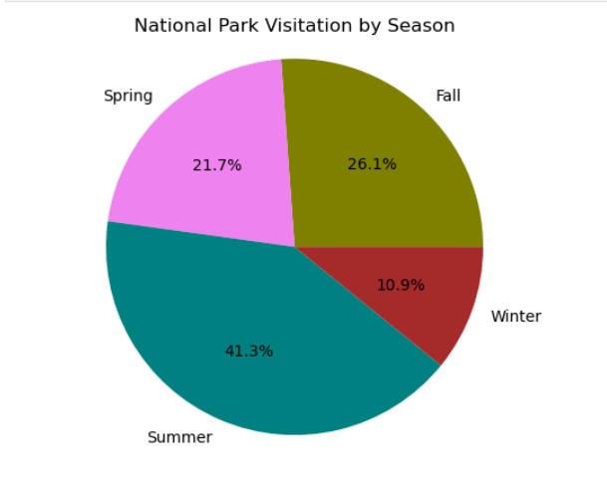
What is the most popular season to visit the national parks?
After calculating the total number of visits to The National Parks in 2023, these are the percentages of visits within a given season.
Summer – 41.3%
Fall – 26.1%
Spring – 21.7%
Winter – 10.9%
Summer is the most popular time of year!

Slide 18
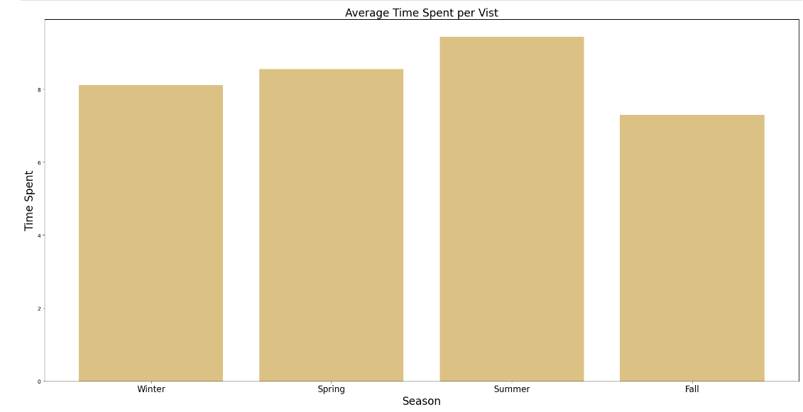
What is the average time spent per visitor in the park by season?
Summer had the highest average time spent per person at the parks.
Summer – 9.43 hours
Spring – 8.55 hours
Fall – 8.11 hours
Winter – 7.29 hours

Slide 19
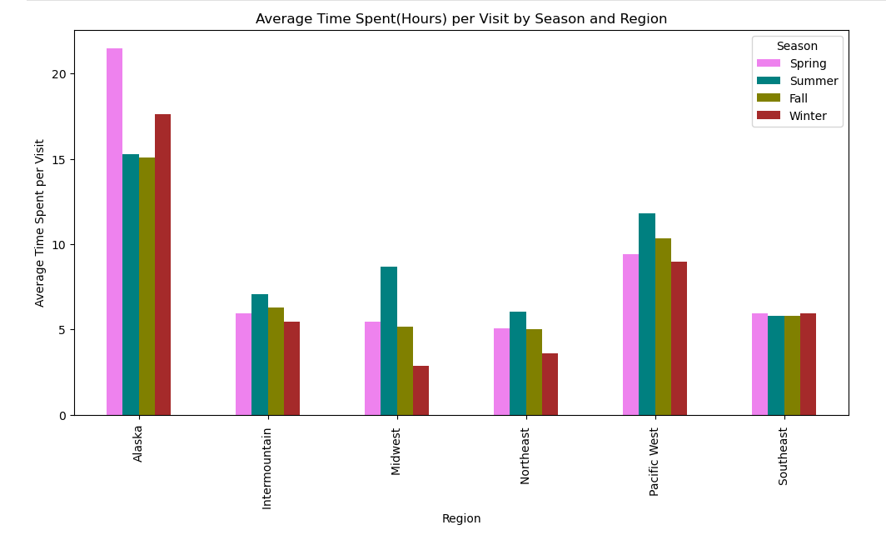
What is the average time spent per visitor in the park by season and region?
Out of the 6 regions, Alaska had the highest time spent in its parks.
Spring time had the longest visits in Alaska at 21.48 hours. Fall had the shortest time spent at 15.08 hours.
The average time spent in the Southeast was consistent at just under 6 hours in each season.
Winter in the Midwest had the shortest time spent at 2.86 hours.

Slide 20
Why are we seeing these results? What things correlate to the results we see?

Slide 21

America’s Largest National Park
At 13.2 million acres, the park is as large as Yellowstone National Park, Yosemite National Park, and Switzerland combined! (Also, equals six Yellowstones)

Slide 22
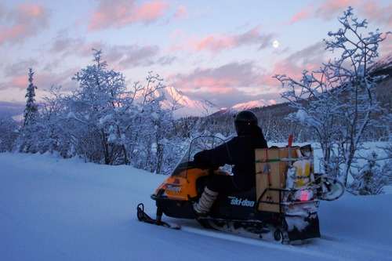
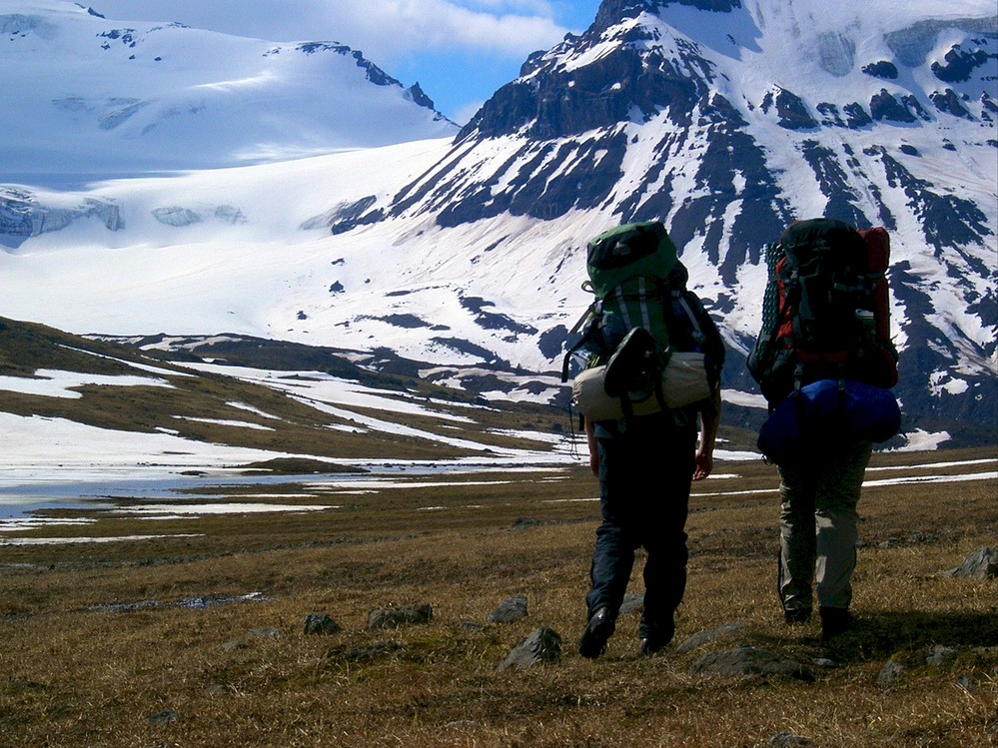

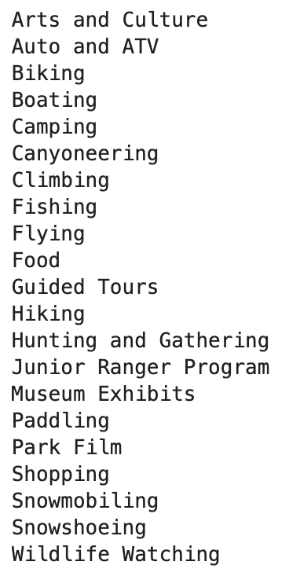

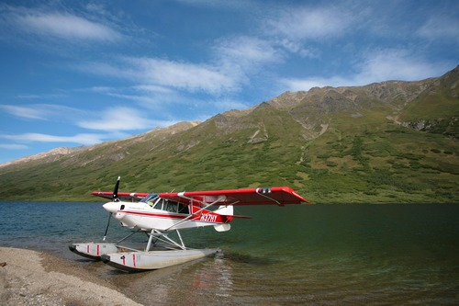

Slide 23
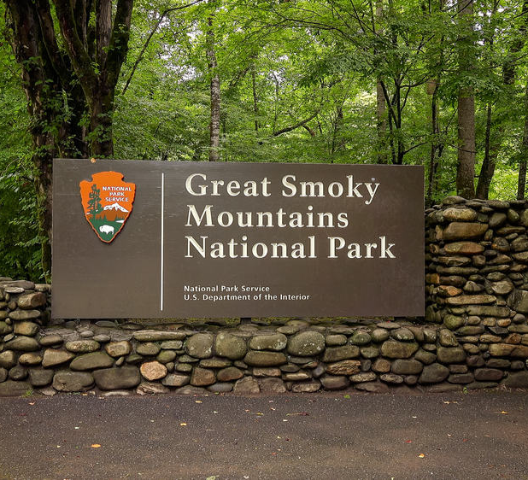
America’s most visited national park
World renowned for its diversity of plant and animal life, the beauty of its ancient mountains, and the quality of its remnants of Southern Appalachian mountain culture, this is America’s most visited national park.

Slide 24
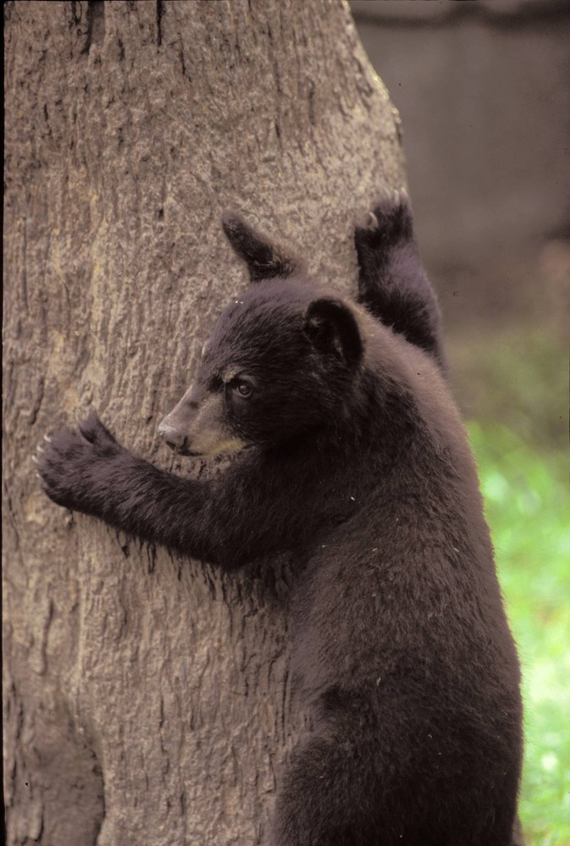
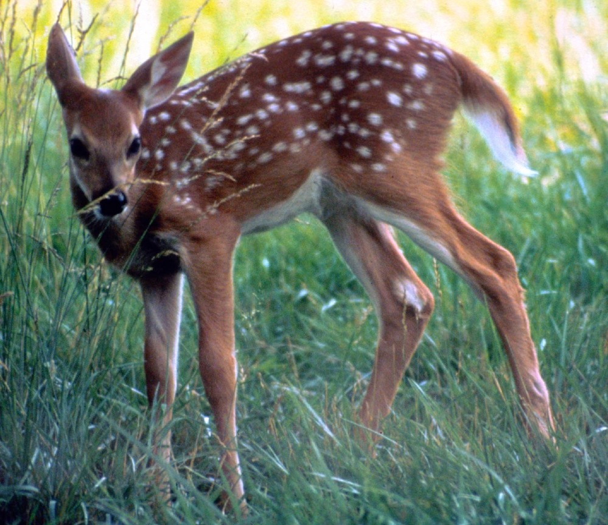

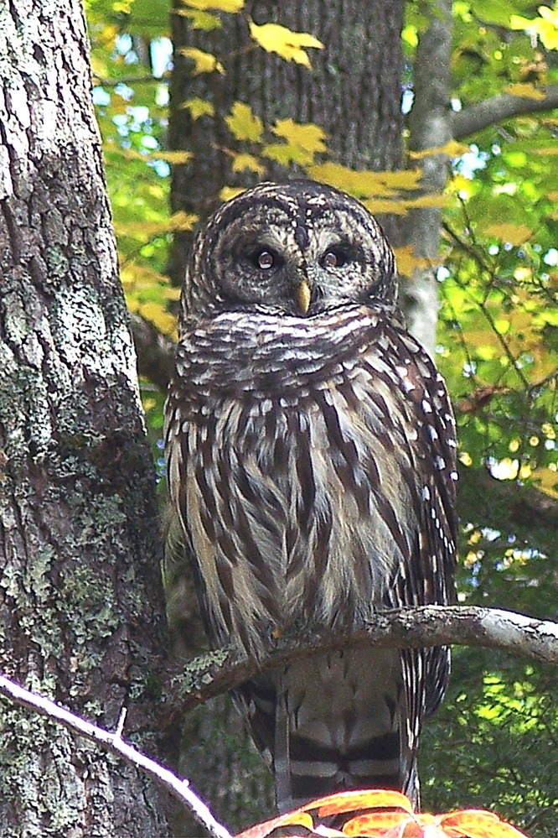
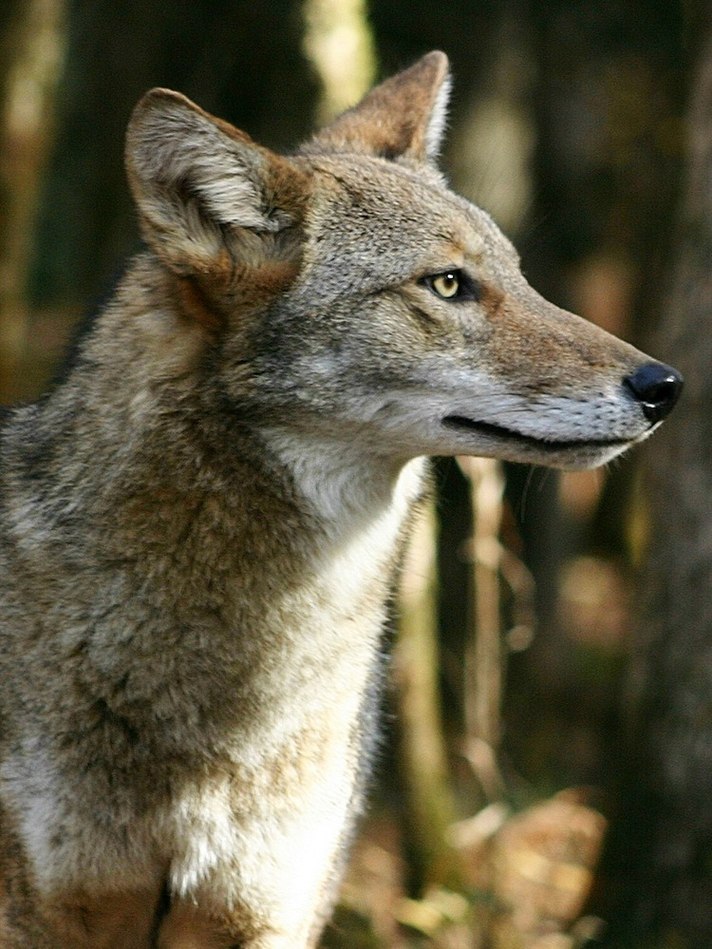
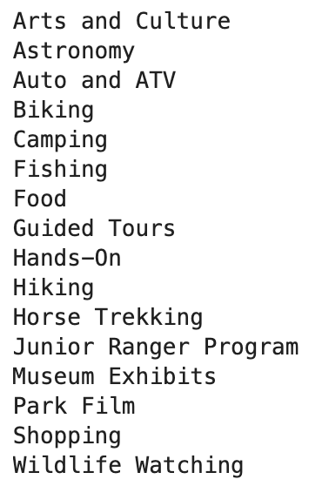
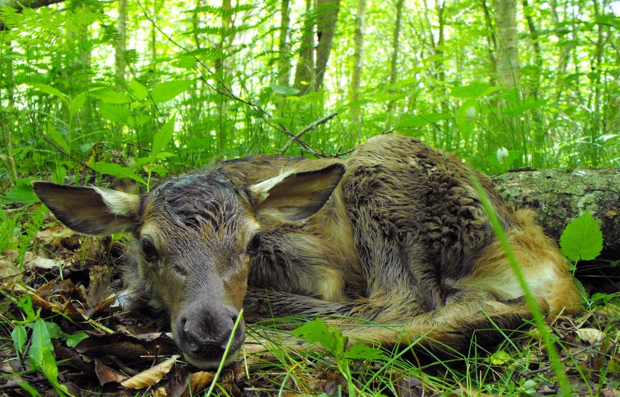
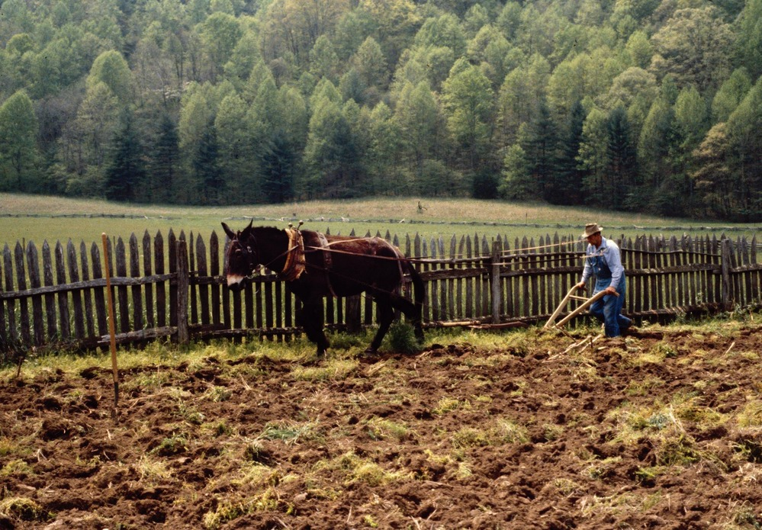

Slide 25
In conclusion,
We found that The Great Smokey Mountains was the most popular National Park when you analyze the total number of visits in a year, and total hours spent in a year. The Wrangell–St. Elias National Park is an anomaly because it is very popular when looking at the average length of visit per visitor.

Slide 26
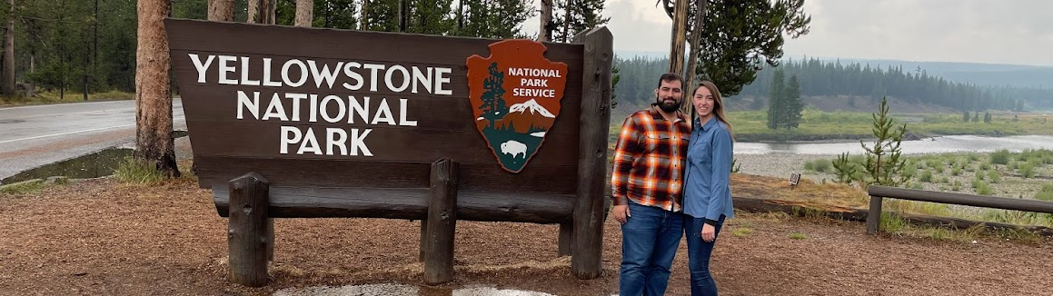
Works cited
https://developer.nps.gov/api/v1/activities/parks
https://developer.nps.gov/api/v1/activities/parks
https://developer.nps.gov/api/v1/activities/parks
https://developer.nps.gov/api/v1/activities/parks
Query Builder for Public Use Statistics (2023)
https://irma.nps.gov/Stats/Reports/National
Latitude and Longitude of National Parks in United States
https://www.latlong.net/category/national-parks-236-42.html
National Park Service Data API
https://developer.nps.gov/api/v1/activities/parks

